Slide 1



Slide 2

Outline
Introduction
Guiding Principle
Membership
Investment Models

Slide 3
Introduction
A Network of professional women who are devoted in supporting young women led business with money and technical support.
The Network members are encourage to invest personal funds into young entrepreneurial women in addition to mentoring and coaching.

Slide 4
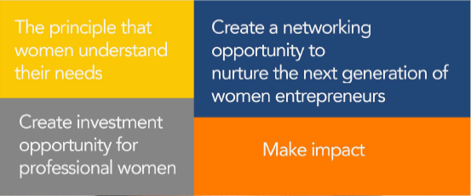
Guiding Principle
“You never change things by fighting the existing reality”
“To change something, Build a new model that makes the existing model obsolete”
R. BUCKMINSTER FULLER

Slide 5
Membership
Strict membership
Invitation only
Commit to invest within a two year period
Willing to coach or mentor a young entrepreneur
Payment of subscription

Slide 6
Member Benefits
Opportunity to network with fellow women at senior level
Availability of investment opportunities
Ability to give back to society through impact investing
Board seats
Investment Capacity development
Build wealth

Slide 7
Investment Models
Monthly
Investment
Quarterly Investment
Semi-Annual Investment
Annual
Bulk as and When

Slide 8
Investment Instruments
Mostly convertible debts
Preference shares
Straight debt

Slide 9
DEAL SELECTION
Call for Applications
Selection Committee
One Month Session
Weekend Boot camp
Pitch Session
Depends on how much is needed, We select them

Slide 10
OPERATIONS
LAN (MEMBERS)
Early-Stage
PROCESS
Deal Flow
Due Diligence
ANGELS
Investment Committee
Valuation
Deal Structure

Slide 11
THANK YOU

